Slide 1
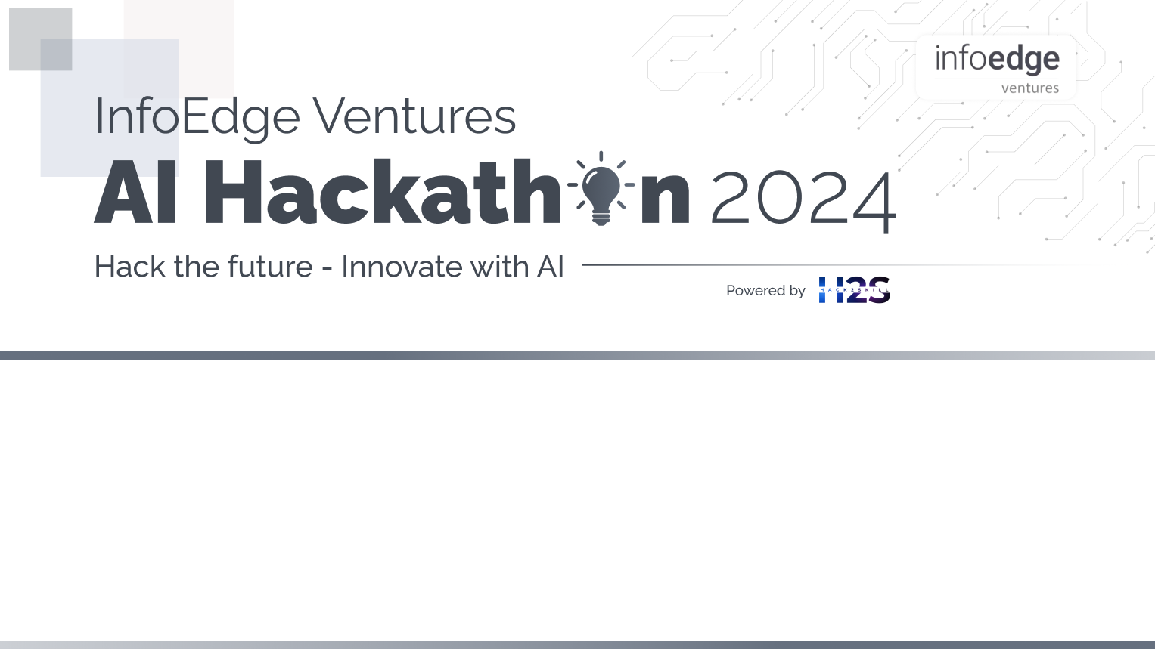
Team Details
Team Name : whiterock
Leader name : Packia vinslin D
Statement : Make the books & Documents easier to read using LLMs(EX. hard into simple lang editions)

Slide 2
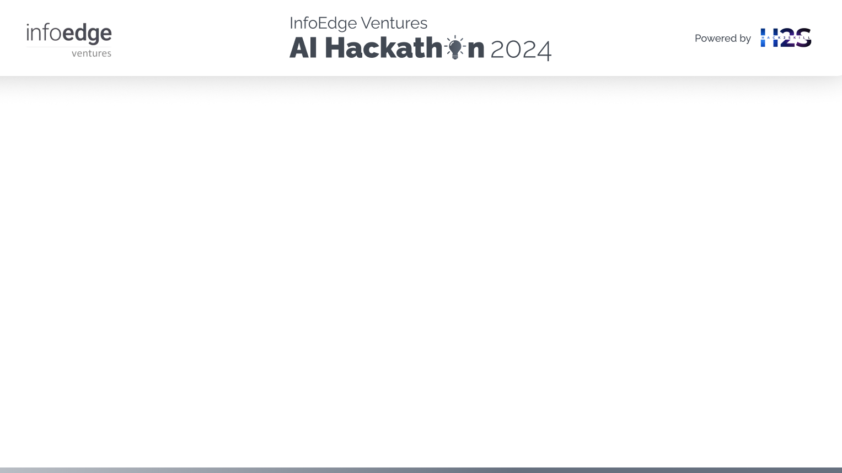
Brief about the idea
To develop an application that simplifies complex English or native language text found in PDF books into easy-to-understand English. The application will also identify difficult words within the text and provide their simpler definitions or translations in the reader's native language, integrating these simplified versions seamlessly into the original paragraph.
This tool aims to improve readability and comprehension for users who struggle with complex language, thereby promoting better learning and understanding.
Innovate methods for handling image-based or photocopied PDFs using computer vision techniques. The aim is to develop advanced solutions that enhance the extraction and processing of text from such PDFs, ensuring accurate recognition and improved readability.

Slide 3
How different is it from any of the other existing ideas?
our approach automates book lang simplification and translation, using OCR and GEMINI APIs for efficiency, consistency, and scalability, unlike manual rewriting.
You can create your own simplified version of the book without any burden
Especially documents.
The whole thing is in automation, no labour work ,no paperwork and also you can create easy readable version for any Book

Slide 4
How will it be able to solve the problem?
Automates Text Simplification: Transforms complex English text into simpler language efficiently, reducing the need for manual rewriting the whole book.
Handles Image-Based PDFs: Uses OCR and computer vision to extract text from image-based or photocopied PDFs, making all content accessible.
Reduces Costs: Leverages automation and APIs to lower costs compared to manual text simplification and rewriting, ensuring a cost-effective solution.

Slide 5
USP of the proposed solution :
Efficient and Cost-Effective Book & Document Simplification:
The solution automates the process of transforming complex English text and translating difficult words, handles image-based PDFs using OCR, and integrates seamlessly with APIs. This combination ensures consistent, scalable, and affordable text simplification, making complex content accessible with minimal manual effort and cost.

Slide 6
List of features offered by the solution
Beginner and Intermediate Modes: Offers two levels of simplification based on user fluency ,beginner mode and intermediate mode.
Output as Text File: Provides the simplified and translated text as an output text file for easy access and use.
Hard Word Identification: Uses the Gemini API(replaced by any LLMs) to identify difficult words and provide simpler definitions.
Automated Text Simplification: Converts complex English text into easier-to-understand language automatically.

Slide 7
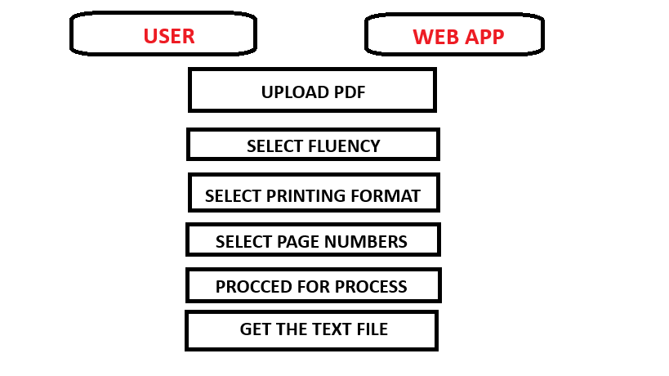
Use-case diagram

Slide 8
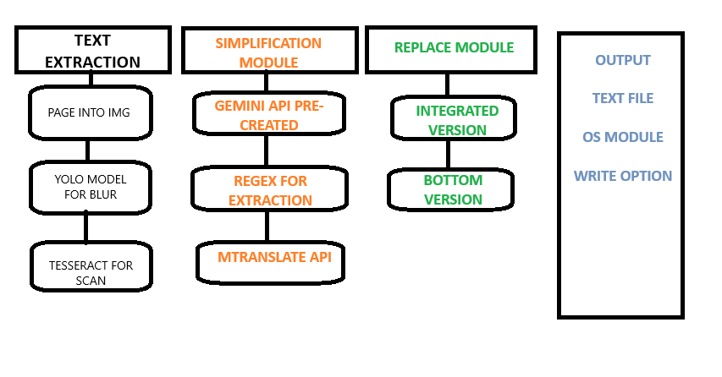
Architecture diagram of the proposed solution

Slide 9
Technologies to be used in the solution:
TESSERACT OCR – For text extraction
YOLO V8 – To find and remove unwanted objects like diagram
GEMINI AI ,NLTK -- To find hard words and rephrase the paragraph
MTRANSLATE API -- Translate one lang into another
REGEX -- Python ‘ re ’ library

Slide 10
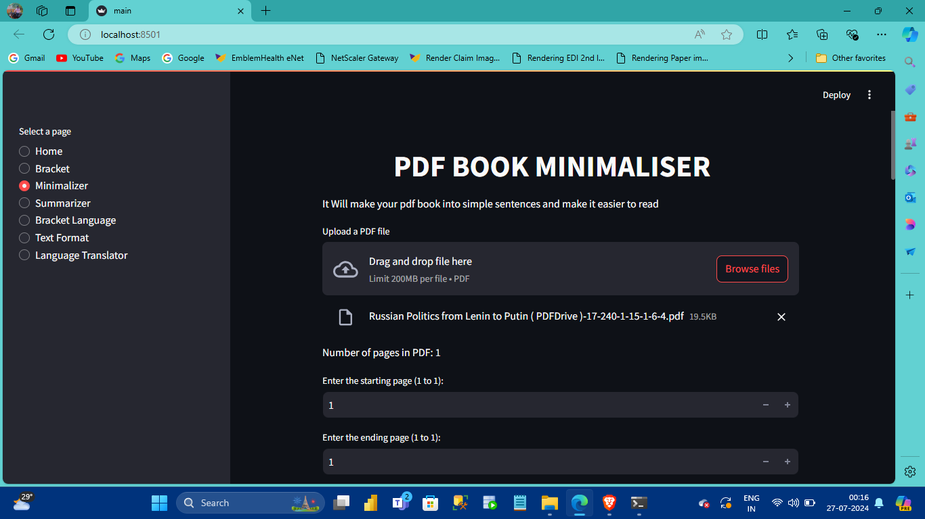
SNAPSHOTS OF THE PROTOTYPE

Slide 11
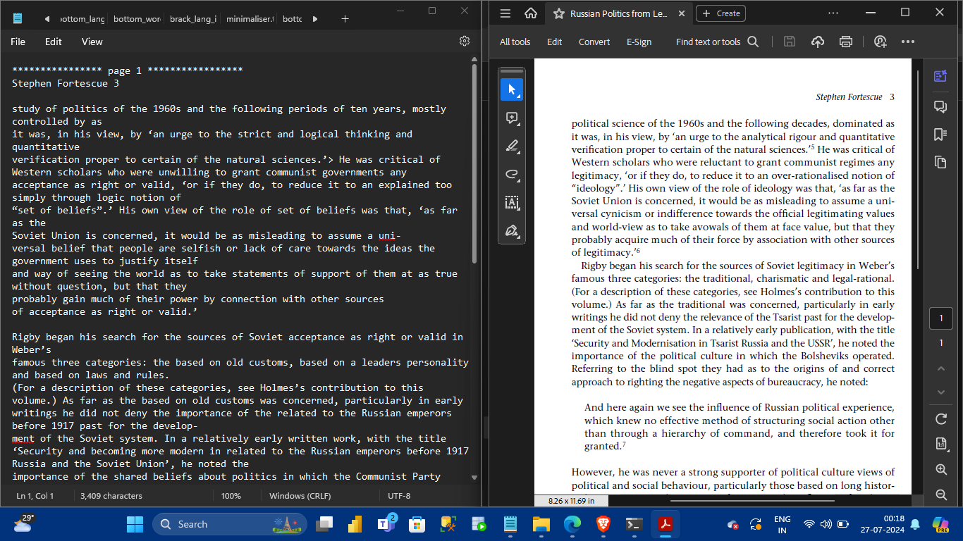
MINIMALIZED WORDS

Slide 12
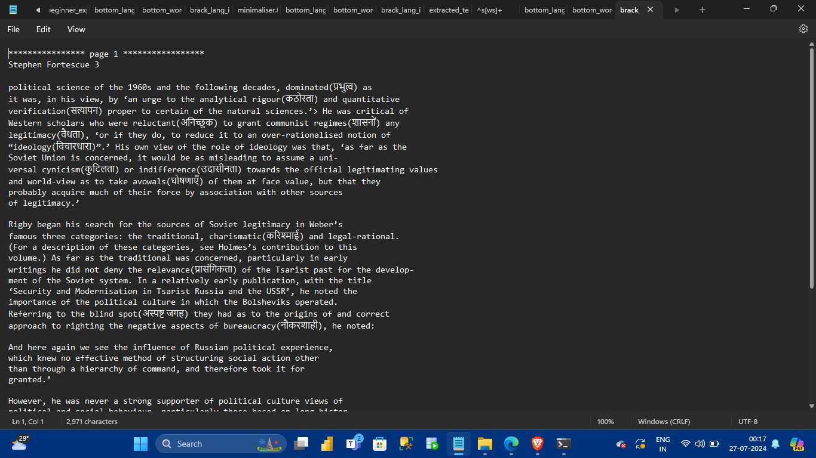
LANGUAGE ORIENTED

Slide 13
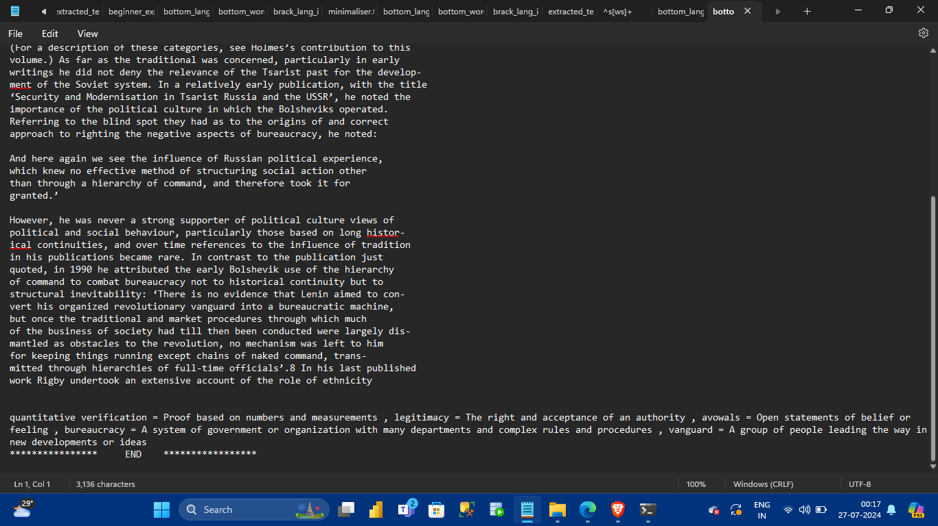
SAME LANGUAGE EXPLANATIONS

Slide 14
Prototype Performance report/Benchmarking :
Accuracy and Efficiency : The prototype effectively extracts text from both digital and scanned PDFs with over 90% accuracy using Tesseract OCR. Text simplification and translation show a high accuracy rate, ensuring readable and coherent outputs.
Processing Speed : On average, the app processes a 100-page PDF in under 5 minutes, making it suitable for quick turnarounds. The use of efficient algorithms and APIs contributes to this speed.

Slide 15
Future Development :
LLM for Book Rephrasing : Integrate a Large Language Model (LLM) like GPT-4 to rephrase complex text, ensuring high-quality, readable, and natural simplifications. This can provide users with varying levels of rephrasing options, from basic to comprehensive.
Book Language Translator Using LLM : Use an LLM to translate entire books into multiple languages accurately, maintaining fluency and contextual appropriateness. This will enable users to access simplified content in their native languages.
Chapter-Wise Processing : Implement chapter-wise processing, allowing users to upload, review, and edit books incrementally, enhancing workflow efficiency and making it easier to handle large texts.

Slide 16
GitHub link : https://github.com/vinslin/pdf_minimaliser/tree/main
Demo video URL : https://www.youtube.com/watch?v=EqXR-VegBmU

Slide 17


